Slide 1
D3 (Day 3)
Let’s do some fancy stuff

Slide 2
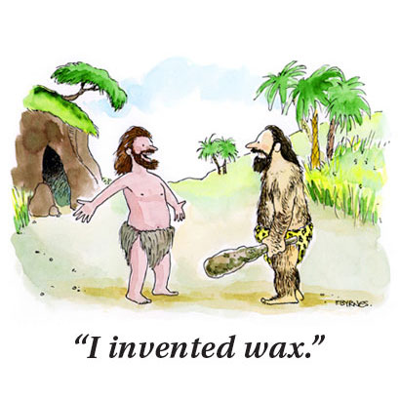
Making Stuff Look Fancy

Slide 3

Transitions

Slide 4
Transition
var t = d3.transition() .duration(750) .ease(d3.easeLinear); d3.selectAll(".apple").transition(t) .style("fill", "red"); d3.selectAll(".orange").transition(t) .style("fill", "orange");

Slide 5
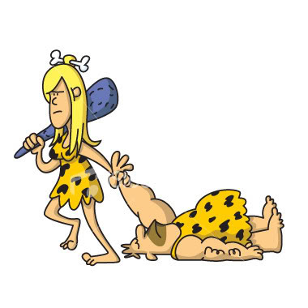
Dragging (d3-drag)

Slide 6
Dragging with D3
d3.drag - create a drag behavior.
drag - apply the drag behavior to a selection.
drag.container - set the coordinate system.
drag.on - listen for drag events.

Slide 7
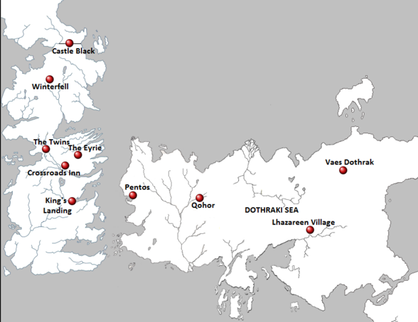
D3 Maps

Slide 8
D3 Maps
D3 Geo https://d3-geomap.github.io/ http://enjalot.github.io/intro-d3/maptime/geo/
DataMaps http://datamaps.github.io/

Slide 9


Slide 10


